Slide 1
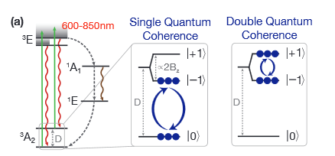
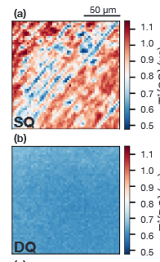
Double Quantum with Floquet
Goal: Create and readout double quantum state
(e.g arXiv:2009.02371)
Application: Remove strain inhomogeneity

Slide 2
How to Double Quantum
Two MW frequency drive
Floquet driven system?

